Slide 1


Social Buzz Dashboard

Slide 2


Today's agenda
Project recap
Problem
The Analytics team
Process
Insights
Summary

Slide 3

Social buzz has seen a tremendous growth in recent times and it is in
need to adapt quickly to stay in the market.
Accenture has begun to focus on The below task as per Social Buzz
requirement to play its game in global scale:
An audit of Social Buzz’s big data practice
Recommendation for a successful IPO
Social Buzz’s top 5 most popular categories of content
Project Recap

Slide 4


Problem
Over 100,000 posts per day
36,500,000 posts on an average per year
How to capitalize on such a huge data and to make the best use of it?
Its by finding Social Buzz’s top 5 most popular categories of content

Slide 5



The Analytics team

Slide 6
Process
1
Data understanding
2
Data cleaning
3
Data modelling
4
Data analysis
5
Uncover insights

Slide 7

Insights
Unique categories
Reaction to animal posts
Month with most posts
16
1897
January

Slide 8
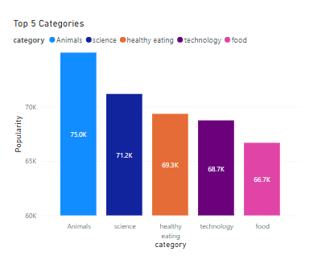
Top 5 category based on their popularity

Slide 9
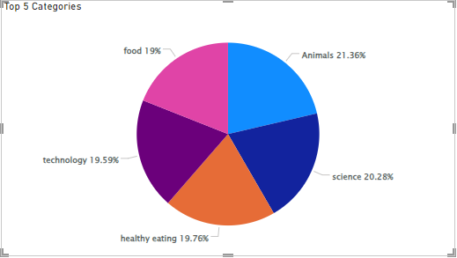
Popularity percentage share from top 5 categories

Slide 10

ANALYSIS
Animals and science are the two most popular categories of content, showing
that people enjoy "real-life" and "factual" content the most.
INSIGHT
Food is a common theme with the top 5 categories
with "Healthy Eating" in the 3rd ranking and "Food" in the 5th rank. This may
give an indication to the audience within your user
base. You could use this insight to create a
campaign and work with healthy eating brands to
boost user engagement.
Since "Animal" is the most popular category, a tie up with pet services such as pet clinics, pet stores would be benificial and also offers/recognition to users who regularly contribute valuable content
Summary
NEXT STEPS
This ad-hoc analysis is insightful, but time to take this analysis into large scale production for real-time understanding of your business. We can show you
how to do this.

Slide 11

Thank you!
ANY QUESTIONS?

